Slide 1
Variations in Hospital Charge and Its Determinants
Capstone Project By: Amanuel Sidamo
Data Science Cohort 2
Nashville Software School
May,2019

Slide 2
Why there are variations in Hospital charge for same Procedures?
Monopolistic Competition in Healthcare Sector
Monopolistic competition that allows providers to set their own prices for same procedures.
The monopolistic power to the providers comes from either real or perceived differences in quality of medical and related services.
In health sector new technologies can also be used to signal quality even when their clinical usefulness is not proven.
Cost Shifting : charging the insured patients more to compensate less collections from uninsured people.
Over Head Cost and Technology: Facilities with more specialized headcounts or using latest technology may charge higher.
Location of Operation: Hospitals in Urban areas may charge higher to compensate cost of operations and wage differences.

Slide 3
Objective of the Project
To explore the extent of variations in hospital charge geographically and by Procedures types
To validate if hospital charge is merely administrative decision or there are market factors explaining hospital charge other than market power of hospitals to set their own prices

Slide 4
Data Source and Description
Medicare outpatient Hospital Charge and Hospital Information data are taken from CMS website
County Health data is taken from Robert Johnson Foundation County Health Ranking
49 States and DC, excluding Maryland, over 1121 counties
35 Procedures(Ambulatory Payment Classifications), over 3000 Providers
The data represents 15.9% (428 million) of Outpatient Prospective Payment System(OPPS) hospital services and 23.3% ($14.3 billion) of the total Medicare allowed amount charges in a year.
Only One year Data is used because of differences in data structure for previous years.
All inferences and conclusions are based on and for 2016 Only.

Slide 5
Definition of Terms
Average Estimated Submitted Charges : The provider's average estimated submitted charge for services covered by Medicare for the Procedure(APC).
Average Total Payments : The average amount Medicare paid to the hospitals plus co-payment and deductible amounts that the patient is responsible for. (Allowed Amount)
Average Medicare Payment Amount : The average amount Medicare paid to the hospitals or providers.

Slide 6
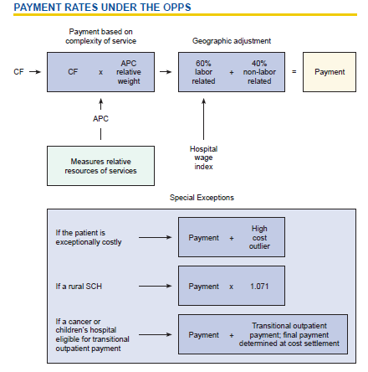
Calculation of Average Total Payments

Slide 7
Exploration of Medicare Outpatient Charge Data
stats | Comprehensive APC Services | Average Estimated Total Submitted Charges | Average Medicare Allowed Amount | Average Medicare Payment Amount | Outlier Comprehensive APC Services | Average Medicare Outlier Amount
count | 27652.00 | 27652.00 | 27652.00 | 27652.00 | 17130.00 | 3387.00
mean | 101.38 | 41633.24 | 7755.54 | 6756.04 | 7.50 | 1550.50
std | 225.45 | 36341.61 | 6696.64 | 6508.88 | 30.15 | 1079.98
min | 11.00 | 214.43 | 105.81 | 101.96 | 0.00 | 137.63
25% | 19.00 | 18362.50 | 3557.55 | 2805.68 | 0.00 | 1016.61
50% | 37.00 | 29937.88 | 5010.95 | 3959.43 | 0.00 | 1293.52
75% | 85.00 | 52103.52 | 9000.21 | 7717.88 | 0.00 | 1727.71
max | 4959.00 | 512630.39 | 43837.58 | 42549.58 | 1067.00 | 18819.48

Slide 8
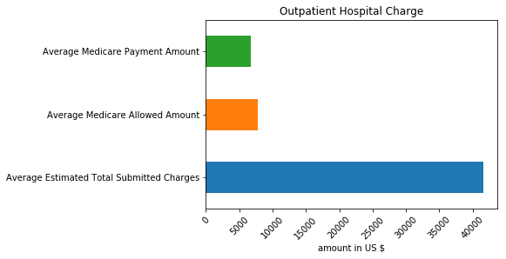
Submitted Charge vs Medicare Allowed Charges
Large gap between Medicare Allowed charges and what the Providers charge

Slide 9
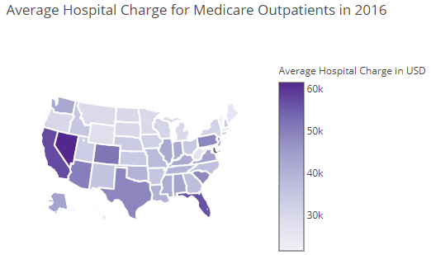
Average Charge By State for Medicare Outpatient
States Like Nevada, California and Florida charged highest in Average in 2016.

Slide 10
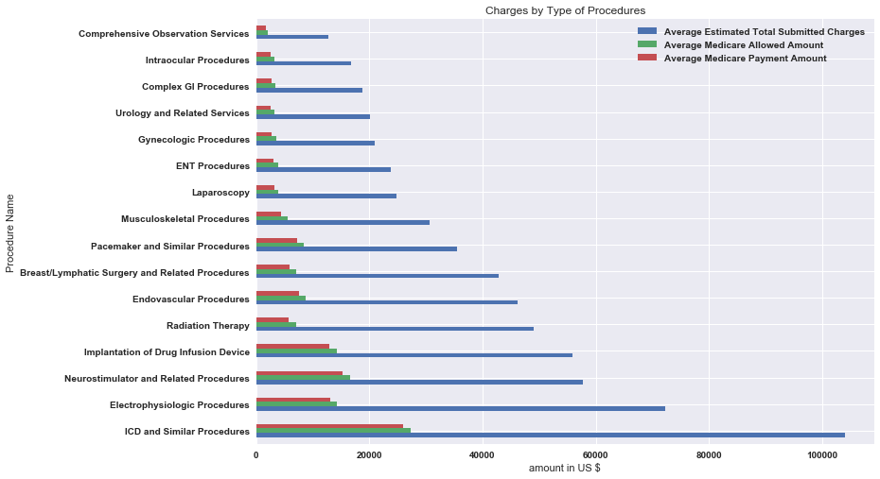
Median of Average Charge By Procedure Name
ICD and Related Procedures are the highest charged Procedures, Compressive Observation Services were least charged
ICD: Implantable Cardioverter Defibrillator Procedures

Slide 11
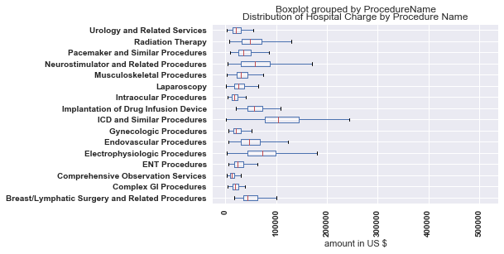
Distribution of Hospital Charge By Procedure Name
Highest Charged
Procedures like ICD, Electrophysiologic Procedures, and Neurostimulator and Related Procedures have the highest variations.
While least charged procedures have less variations in Charge amounts

Slide 12
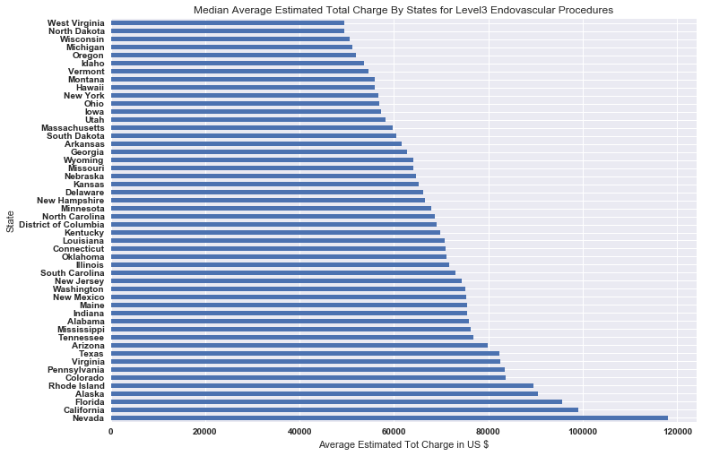
Median of Average Charge For Level 3 Endovascular Procedures
States Like Nevada ,California and Florida charged double of charges in lowest charging States.

Slide 13
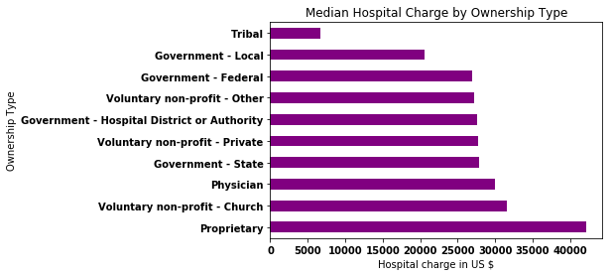
Hospital Charge by Hospital Ownership Type
Proprietary Hospitals charged the highest amount , Local Government Hospitals charged the lowest in average,
Federal Government and Voluntary non-profit hospitals charged comparable amount.

Slide 14
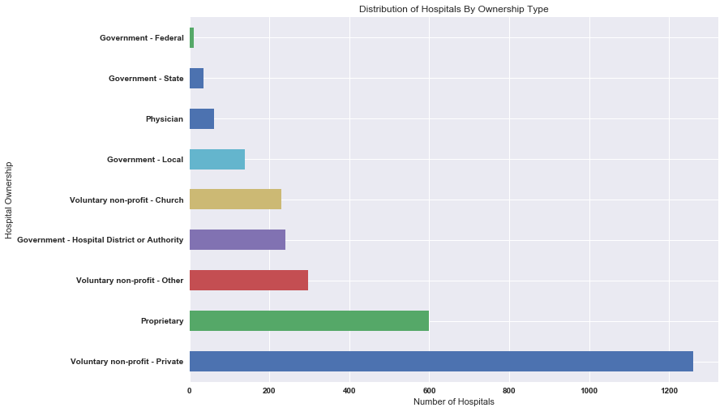
Number of Hospitals By Ownership Type
Over 1200 voluntary non-profit-private and followed by proprietary hospitals.

Slide 15
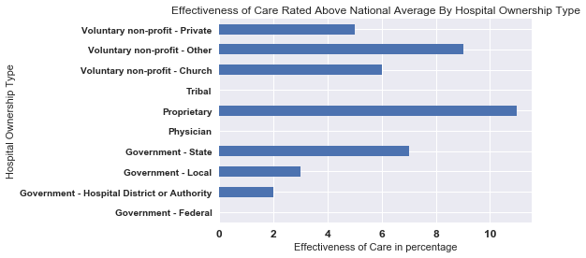
Is there Quality Difference by Ownership Type? Quality of Care by Ownership Type
Proprietary Hospitals had highest percentage rated as Above National Average

Slide 16
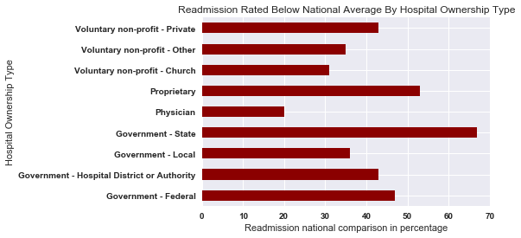
Readmission Type by Ownership Type
State Owned Hospitals had highest percentage rated as Below National Average,
Physician Owned Hospitals had the highest readmission rate in 2016

Slide 17
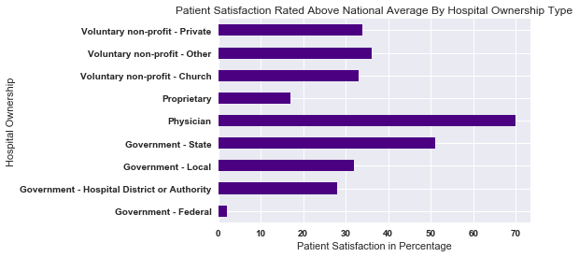
Patient Satisfaction by Ownership Type
Physicians Owned Hospitals had highest percentage rated above national average in terms of patient satisfaction

Slide 18
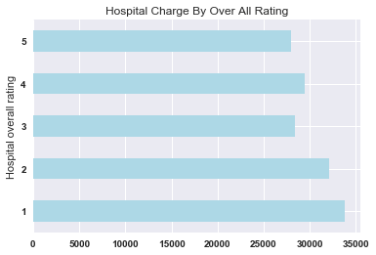
Median Charge by Level of Star
Lower Star Hospitals Higher Median Charge, Except Star-3

Slide 19
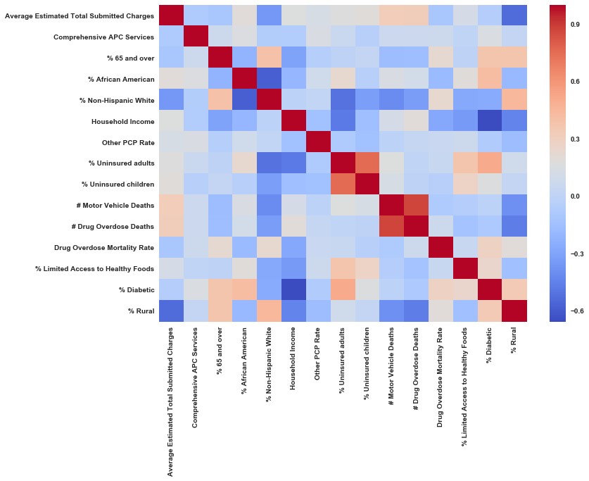
Correlation between Hospitals Charge Data County Health Ranking Data

Slide 20
Test, Train data and Models
Data Grouped by County (1121 counties)
0.33 % Test Data
Target Variable: Mean of Average Submitted Hospital Charges
Features: % 65 and over, % African American, % Non-Hispanic White, Household Income, other to PCP Rate, %Uninsured Adults, % Uninsured children, # MV Deaths, #Drug Over Deaths, Drug Overdose Mortality Rate, % Limited Access to Healthy Foods, % Diabetic, % Rural.
Lasso Model
Linear Regression in sklearn
OLS Model
Random Forest

Slide 21
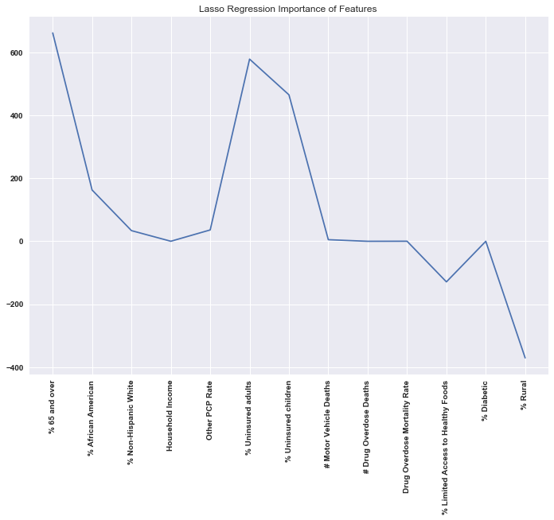
Lasso Regression Result

Slide 22
OLS Regression for Selected Variables
Only 35% of Hospital Charge variation is explained by these variables. This may confirm the Hospital charge mostly determined by market power of the hospitals (Administrative Decision)
Dep. Variable: Average Estimated Total Submitted Charges R-squared: 0.355
Model: OLS Adj. R-squared: 0.352
Method: Least Squares F-statistic: 122.8
Date: Sat, 11 May 2019 Prob (F-statistic): 0.000
features | coefficients | std err | T-stat | P>|t| | [0.025 0.975]
constant | 24360.000 | 2293.120 | 10.625 | 0.000 | 19900.000 | 28900.000
% Uninsured adults | 350.482 | 114.147 | 3.070 | 0.002 | 126.514 | 574.449
% Uninsured children | 623.635 | 229.121 | 2.722 | 0.007 | 174.078 | 1073.193
% 65 and over | 592.680 | 122.531 | 4.837 | 0.000 | 352.263 | 833.098
% Rural | -419.393 | 19.287 | -21.745 | 0.000 | -457.236 | -381.550
% African American | 131.048 | 39.052 | 3.356 | 0.001 | 54.424 | 207.672

Slide 23
Moving Forward
Take one Procedure and Do the whole Analysis for specific Procedure.
Trying to find market power indicator and include in the model(CCR data).

